Slide 1
Notes:
Alicia

Slide 2
Executive Summary
Background: LEF QA tool
Tech LEF File(s): finds, extracts layer info
LEF File(s): finds, extracts property/cell info, sorts, creates sorted LEF file(s)
LIB File(s): selected by user, extracts cell info, compares LIB cell info with LEF cell info
Problems:
Sorting is not consistent between script executions
Port Pin Layers are not sorted correctly
Proper script execution is not clear to new users
Output file location is not clear to users
Origin of errors is not clear for every test
Goals: Fix current problems in the script regarding sorting, as well as make it more clear to the user how the script needs to be run, and how the output is handled.
Improvements:
Fixed issue of Port Pin Layers not sorting correctly
Added option to manually pass in a LEF file to sort
Help menu displays when script is run with no args
Improved clarity in description displayed when running script
Notes:
Alicia

Slide 3
Problem Statement
Library Exchange Format (LEF) files
Abstract views of a standard cell’s layout
Used by Place and Route (P&R) tools
LEF files are not generated consistently
LEF file generation tools don’t always generate file contents in the same order
LEF files need to be sorted in the same manner
Can then determine changes between different versions of the same LEF file
Notes:
Bobby
P&R tools place cells and then route metal layers between pin coordinates within cells

Slide 4
Outline
Background
Prior Work
Problems & Goals
Improvements
Future Work
Conclusion
Notes:
Bobby
Here is a summary of what we will be talking about today:
We will start off with "What is a LEF file", and some of the intrinsic properties of a LEF file.
Then we will talk about the Quality Assurance script and how it can be used as a tool to validate LIB and LEF files as well as create a sorted version of the LEF file.
After that, we will go over some of the quality assurance checks that take place when using this tool.
Then we will demonstrate the tool and conclude with possible future improvements.

Slide 5
Background - LEF
LEF: Library Exchange Format
Abstract view of a standard cell’s layout
Only contains layout info needed by P&R tools
Example: Inverter →
Cell P&R
Boundary
I/O Pins
Routing
Obstructions
Layout View
Abstract View
Notes:
Chris
Routing blockage
Given a specified area
The obstruction blocks nets from being routed using specific layers

Slide 6
Background - LEF Files
LEF file
Text file in ASCII format
Contains abstract layout views of the cells in an IC
Used by P&R tools to route cells properly
File Hierarchy:
Property Statements
Cell Macro 1
Cell Property Statements
Pin Statements
Obstruction Statements
Cell Macro 2
Cell Macro 3
⁞
Cell Macro N
Notes:
Chris
High-level properties
Cell macros
Contain the abstract layout view info for each cell
Properties of the cell
Info for each pin in the cell
And info for each obstruction
Routing blockage
Given a specified area
The obstruction blocks nets from being routed using specific layers

Slide 7
Background - LEF File Macros
Inverter Cell Macro:
MACRO macroName
CLASS CORE ;
FOREIGN foreignCellName 0.000 0.000 ;
SIZE 3.00 BY 12.00 ;
SYMMETRY x y ;
SITE CORE ;
PIN pinName
DIRECTION INPUT ;
ANTENNASIZE 1.4 ;
PORT
LAYER metal1 ;
RECT 0.50 5.00 1.00 5.50 ;
END
END pinName
⁞
OBS
LAYER metal1 ;
RECT 1.90 6.50 2.60 7.20 ;
RECT 0.40 4.90 1.00 5.60 ;
END
⁞
END macroName
Cell Properties
I/O Pins
Routing
Obstructions
Layout View
Abstract View
*code used from Dr. Adam Teman of Bar-Ilan University, Lecture 4
Notes:
Chris
Routing blockage
Given a specified area
The obstruction blocks nets from being routed using specific layers

Slide 8
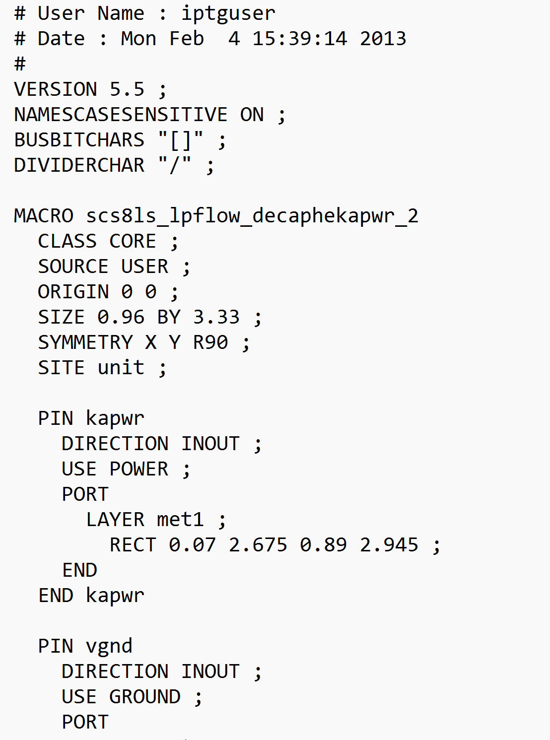
Background - LEF Syntaxes
[VERSION statement]
[BUSBITCHARS statement]
[DIVIDERCHAR statement]
[VIA statement] …
[SITE statement]
[MACRO statement] …
[BEGINEXT statement] …
[END LIBRARY]
LEF/DEF Manual syntax:
- Syntax used in LEF/DEF manual
LEF file syntax:
- Syntax used in LEF files
Notes:
Chris
LEF/DEF Manual syntax
LEF file syntax

Slide 9
Background - LEF Manual Syntax
[VERSION statement]
[BUSBITCHARS statement]
[DIVIDERCHAR statement]
[VIA statement] …
[SITE statement]
[MACRO statement] …
[BEGINEXT statement] …
[END LIBRARY]
LEF/DEF Manual syntax:
- Syntax used in LEF/DEF manual
- Keywords
- Uppercase in manual
- Case insensitive in LEF files
- Brackets, [ ]
- Denote optional arguments.
- Braces, { }
- Denote required arguments.
- When enclosing multiple arguments, must pick one.
- Vertical bars, |
- Separate the possible choices for a single argument.
- Ellipses, …
- Indicate that you can repeat the previous argument.
Notes:
Chris

Slide 10
Background - LEF Hierarchy
[VERSION statement]
[BUSBITCHARS statement]
[DIVIDERCHAR statement]
[VIA statement] …
[SITE statement]
[MACRO statement] …
[BEGINEXT statement] …
[END LIBRARY]
{LAYER layerName
[EXCEPTPGNET] [SPACING minSpacing | DESIGNRULEWIDTH value] ;
[WIDTH width ;]
{PATH [MASK maskNum] pt ... ;
| PATH [MASK maskNum] ITERATE pt ... stepPattern ;
| RECT [MASK maskNum] pt pt ;
| RECT [MASK maskNum] ITERATE pt pt stepPattern ;
| POLYGON [MASK maskNum] pt pt pt pt ... ;
| POLYGON [MASK maskNum] ITERATE pt pt pt pt ... stepPattern ;
} ...
| VIA [MASK viaMaskNum] pt viaName ;
| VIA ITERATE [MASK viaMaskNum] pt viaName stepPattern ;
} ...
LEF file property statements:
- Property statements used in LEF files
Layer Geometries:
- Used in macro OBS/PIN statements
- Defines layer geometries in the design
Notes:
Chris
Blue font colors of keywords
Don’t have any special meaning
Helps reader better visualize the the different levels of keywords

Slide 11
Background - LEF Hierarchy
MACRO macroName
[CLASS
{ COVER [BUMP]
| RING
| BLOCK [BLACKBOX | SOFT]
| PAD [INPUT | OUTPUT |INOUT | POWER | SPACER | AREAIO]
| CORE [FEEDTHRU | TIEHIGH | TIELOW | SPACER | ANTENNACELL | WELLTAP]
| ENDCAP {PRE | POST | TOPLEFT | TOPRIGHT | BOTTOMLEFT | BOTTOMRIGHT}
}
;]
[FIXEDMASK ;]
[FOREIGN foreignCellName [pt [orient]] ;] ...
[ORIGIN pt ;]
[EEQ EEQmacroName ;]
[SIZE width BY height ;]
[SYMMETRY {X | Y | R90} ... ;]
[SITE siteName [sitePattern] ;] ...
[PIN statement] ...
[OBS statement] ...
[DENSITY statement] ...
[PROPERTY propName propVal ;] ...
END macroName
[VERSION statement]
[BUSBITCHARS statement]
[DIVIDERCHAR statement]
[VIA statement] …
[SITE statement]
[MACRO statement] …
[BEGINEXT statement] …
[END LIBRARY]
Notes:
Chris

Slide 12
Background - LEF Hierarchy
MACRO macroName
[CLASS ;]
[FIXEDMASK ;]
[FOREIGN ;] ...
[ORIGIN ;]
[EEQ ;]
[SIZE ;]
[SYMMETRY ;]
[SITE ;] ...
[PIN statement] ...
[OBS statement] ...
[DENSITY statement] ...
[PROPERTY ;] ...
END macroName
[VERSION statement]
[BUSBITCHARS statement]
[DIVIDERCHAR statement]
[VIA statement] …
[SITE statement]
[MACRO statement] …
[BEGINEXT statement] …
[END LIBRARY]
[PIN pinName
[TAPERRULE ruleName ;]
[DIRECTION {INPUT | OUTPUT [TRISTATE] | INOUT | FEEDTHRU} ;]
[USE { SIGNAL | ANALOG | POWER | GROUND | CLOCK } ;]
[NETEXPR "netExprPropName defaultNetName" ;]
[SUPPLYSENSITIVITY powerPinName ;]
[GROUNDSENSITIVITY groundPinName ;]
[SHAPE {ABUTMENT | RING | FEEDTHRU} ;]
[MUSTJOIN pinName ;]
{PORT
[CLASS {NONE | CORE | BUMP} ;]
{layerGeometries} ...
END} ...
[PROPERTY propName propVal ;] ...
[PROPERTY LEF58_VIAINPINONLY “VIAINPINONLY ; ” ;]
[ANTENNAPARTIALMETALAREA value [LAYER layerName] ;] ...
[ANTENNAPARTIALMETALSIDEAREA value [LAYER layerName] ;] ...
[ANTENNAPARTIALCUTAREA value [LAYER layerName] ;] ...
[ANTENNADIFFAREA value [LAYER layerName] ;] ...
[ANTENNAMODEL {OXIDE1 | OXIDE2 | OXIDE3 | OXIDE4} ;] ...
[ANTENNAGATEAREA value [LAYER layerName] ;] ...
[ANTENNAMAXAREACAR value LAYER layerName ;] ...
[ANTENNAMAXSIDEAREACAR value LAYER layerName ;] ...
[ANTENNAMAXCUTCAR value LAYER layerName ;] ...
END pinName]
Notes:
Chris

Slide 13
Background - LEF Hierarchy
MACRO macroName
[CLASS ;]
[FIXEDMASK ;]
[FOREIGN ;] ...
[ORIGIN ;]
[EEQ ;]
[SIZE ;]
[SYMMETRY ;]
[SITE ;] ...
[PIN statement] ...
[OBS statement] ...
[DENSITY statement] ...
[PROPERTY ;] ...
END macroName
[VERSION statement]
[BUSBITCHARS statement]
[DIVIDERCHAR statement]
[VIA statement] …
[SITE statement]
[MACRO statement] …
[BEGINEXT statement] …
[END LIBRARY]
[OBS
{LAYER layerName
[EXCEPTPGNET]
[SPACING minSpacing | DESIGNRULEWIDTH value] ;
[WIDTH width ;]
{ PATH pt ... ;
| PATH ITERATE pt ... stepPattern ;
| RECT pt pt ;
| RECT ITERATE pt pt stepPattern ;
| POLYGON pt pt pt pt ... ;
| POLYGON ITERATE pt pt pt pt ... stepPattern ;
} ...
| VIA pt viaName ;
| VIA ITERATE pt viaName stepPattern ;
} ...
END]
Notes:
Chris

Slide 14
Background - Tech LEF & Liberty Files
Tech LEF Files
Text file in ASCII format
Contain technology info for design
Synopsys uses .tf files
Cadence uses .tlef files
Liberty (LIB) Files
Text file in ASCII format
Contain timing and electrical info associated with standard library cells
Notes:
Chris
So that covers background info for LEF files
Two other files of importance with respect to LEF QA script:
Tech LEF files
Liberty files
Both of which are in ASCII formatted text files

Slide 15
Prior Work - LEF QA Script
Tech LEF Files
Finds and extracts layer definitions
LEF Files
Finds and extracts property/cell info into hierarchy of hash tables
Sorts extracted info in hash tables
Prints sorted info to new LEF file
LIB Files
Extracts area property and pin properties of cells from LIBs in user-specified directory(s)
Compares sorted LEF files
Compares cell info between LEF and LIB files
Notes:
Bobby

Slide 16
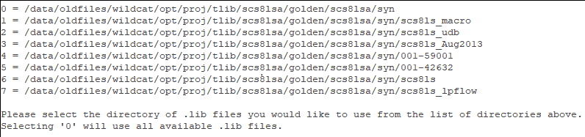
Prior Work - Script Execution
Script must be executed at top of a library
Can instead pass a path to working directory using ‘-w’ option
/config, /pnr, and /syn directories need to be seen below run location
First TLEF/TF file found is parsed for its layer definitions
Can choose specific file using ‘-t’ option
All LEF files found are parsed and sorted
User is prompted to select the LIB directory
Chosen from directories seen under /syn
Output files placed in same directory as LEF files (/pnr)
If user doesn’t have permission to write there, a folder is created in user’s home
Notes:
Bobby
Improvements – manually passing LEF file
These are different technology libraries
Different technology nodes
Different channel lengths etc.
SC – standard cell

Slide 17
Prior Work - Script Options
Specify working directory
-w, --wsdir=WSDIR
Print debugging information
-d, --debug
Specify liberty file directory
-l, --liberty=LIBERTY
Specify path to technology LEF
-t, TLEF
Skip printing large errors (>1000 lines)
-i
Print help menu
-h, --help
Notes:
Bobby

Slide 18
Problems & Goals
No documentation of which LEF syntax keywords aren’t in script
Flowcharts
Poorly represent codebase, not easy to understand
Port Pin Layers are not sorted correctly
No option to manually pass in and sort LEF files
Script execution Clarity
Help menu not displayed when executing without options
Proper execution is not clear to new users
Output file location not clear to users
Miscellaneous
Output files are hidden
Origin of errors is not clear for all tests
Goals: Fix the above problems and any other problems not yet identified
Notes:
Bobby

Slide 19
Improvements - Identify Keyword Discrepancies
Keyword Highlighting:
Only in script
Only in LEF files
Not in LEF files and not in script
No highlighting - In both script and LEF files
*Red and green need to be added to script
[VERSION statement]
[BUSBITCHARS statement]
[DIVIDERCHAR statement]
[VIA statement] …
[SITE statement]
[MACRO statement] …
[BEGINEXT statement] …
[END LIBRARY]
{LAYER layerName
[EXCEPTPGNET] [SPACING minSpacing | DESIGNRULEWIDTH value] ;
[WIDTH width ;]
{PATH [MASK maskNum] pt ... ;
| PATH [MASK maskNum] ITERATE pt ... stepPattern ;
| RECT [MASK maskNum] pt pt ;
| RECT [MASK maskNum] ITERATE pt pt stepPattern ;
| POLYGON [MASK maskNum] pt pt pt pt ... ;
| POLYGON [MASK maskNum] ITERATE pt pt pt pt ... stepPattern ;
} ...
| VIA [MASK viaMaskNum] pt viaName ;
| VIA ITERATE [MASK viaMaskNum] pt viaName stepPattern ;
} ...
Notes:
Chris
Keyword discrepancies between Infineon LEF files and script
Keyword highlighting
Blue – These keywords only appear in the script
Red – These keywords only appear in LEF files and need to be added to the script
Green – The keywords don’t appear in LEF files or script, but need to be added to script
Not highlighted – These keywords are in LEF files and in the script

Slide 20
Improvements - Identify Keyword Discrepancies
MACRO macroName
[CLASS
{ COVER [BUMP]
| RING
| BLOCK [BLACKBOX | SOFT]
| PAD [INPUT | OUTPUT |INOUT | POWER | SPACER | AREAIO]
| CORE [FEEDTHRU | TIEHIGH | TIELOW | SPACER | ANTENNACELL | WELLTAP]
| ENDCAP {PRE | POST | TOPLEFT | TOPRIGHT | BOTTOMLEFT | BOTTOMRIGHT}
}
;]
[FIXEDMASK ;]
[FOREIGN foreignCellName [pt [orient]] ;] ...
[ORIGIN pt ;]
[EEQ EEQmacroName ;]
[SIZE width BY height ;]
[SYMMETRY {X | Y | R90} ... ;]
[SITE siteName [sitePattern] ;] ...
[PIN statement] ...
[OBS statement] ...
[DENSITY statement] ...
[PROPERTY propName propVal ;] ...
END macroName
Keyword Highlighting:
Only in script
Only in LEF files
Not in LEF files and not in script
No highlighting - In both script and LEF files
*Red and green need to be added to script
Notes:
Chris
Macro statement

Slide 21
Improvements - Identify Keyword Discrepancies
Keyword Highlighting:
Only in script
Only in LEF files
Not in LEF files and not in script
No highlighting - In both script and LEF files
*Red and green need to be added to script
[PIN pinName
[TAPERRULE ruleName ;]
[DIRECTION {INPUT | OUTPUT [TRISTATE] | INOUT | FEEDTHRU} ;]
[USE { SIGNAL | ANALOG | POWER | GROUND | CLOCK } ;]
[NETEXPR "netExprPropName defaultNetName" ;]
[SUPPLYSENSITIVITY powerPinName ;]
[GROUNDSENSITIVITY groundPinName ;]
[SHAPE {ABUTMENT | RING | FEEDTHRU} ;]
[MUSTJOIN pinName ;]
{PORT
[CLASS {NONE | CORE | BUMP} ;]
{layerGeometries} ...
END} ...
[PROPERTY propName propVal ;] ...
[PROPERTY LEF58_VIAINPINONLY “VIAINPINONLY ; ” ;]
[ANTENNAPARTIALMETALAREA value [LAYER layerName] ;] ...
[ANTENNAPARTIALMETALSIDEAREA value [LAYER layerName] ;] ...
[ANTENNAPARTIALCUTAREA value [LAYER layerName] ;] ...
[ANTENNADIFFAREA value [LAYER layerName] ;] ...
[ANTENNAMODEL {OXIDE1 | OXIDE2 | OXIDE3 | OXIDE4} ;] ...
[ANTENNAGATEAREA value [LAYER layerName] ;] ...
[ANTENNAMAXAREACAR value LAYER layerName ;] ...
[ANTENNAMAXSIDEAREACAR value LAYER layerName ;] ...
[ANTENNAMAXCUTCAR value LAYER layerName ;] ...
END pinName]
Notes:
Chris
Pin statement

Slide 22
Improvements - Identify Keyword Discrepancies
Keyword Highlighting:
Only in script
Only in LEF files
Not in LEF files and not in script
No highlighting - In both script and LEF files
*Red and green need to be added to script
[OBS
{LAYER layerName
[EXCEPTPGNET]
[SPACING minSpacing | DESIGNRULEWIDTH value] ;
[WIDTH width ;]
{ PATH pt ... ;
| PATH ITERATE pt ... stepPattern ;
| RECT pt pt ;
| RECT ITERATE pt pt stepPattern ;
| POLYGON pt pt pt pt ... ;
| POLYGON ITERATE pt pt pt pt ... stepPattern ;
} ...
| VIA pt viaName ;
| VIA ITERATE pt viaName stepPattern ;
} ...
END]
Notes:
Chris
Obstruction statement
Routing blockage
Given a specified area
The obstruction blocks nets from being routed using specific layers

Slide 23
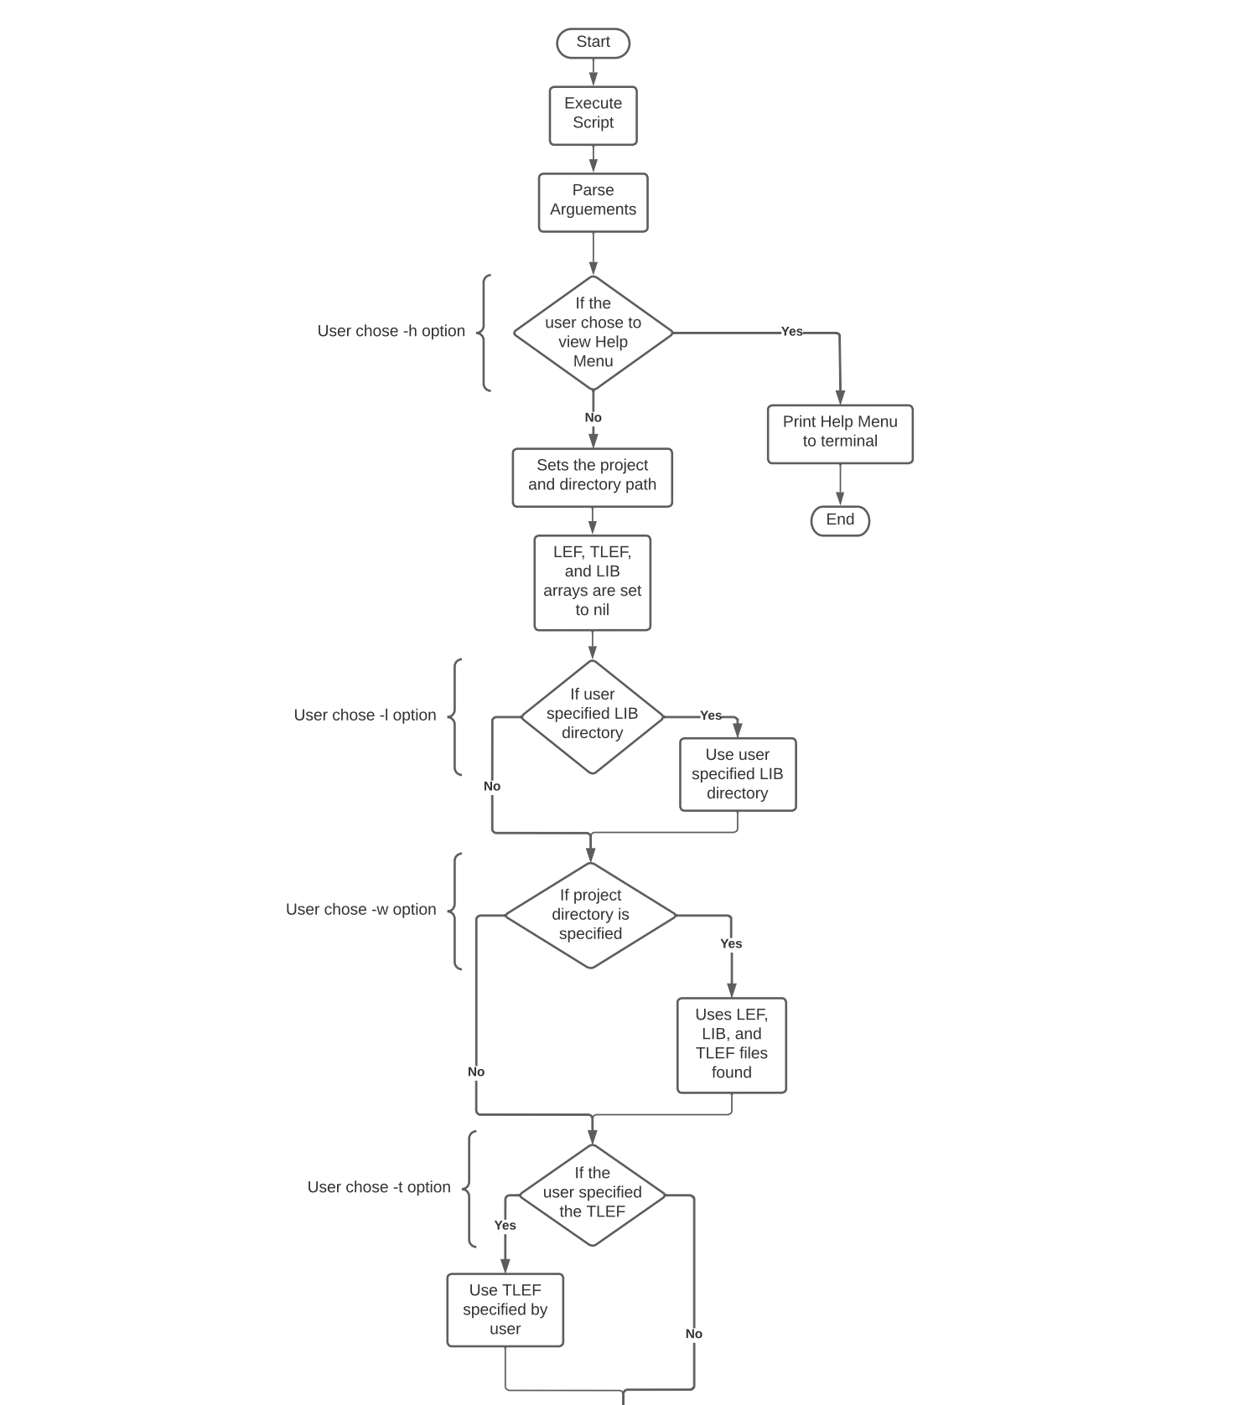
Improvements - Script Flowchart
*Flowcharts created using LucidChart
Notes:
Alicia

Slide 24
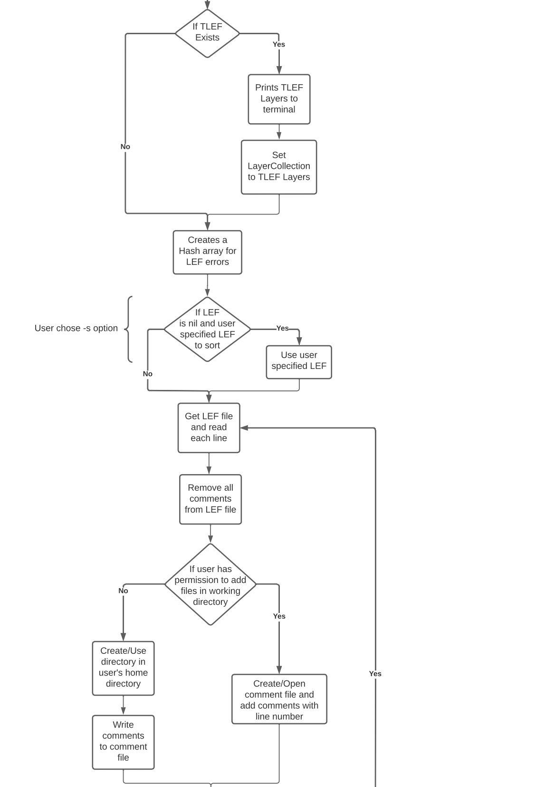
Improvements - Script Flowchart
Notes:
Alicia

Slide 25
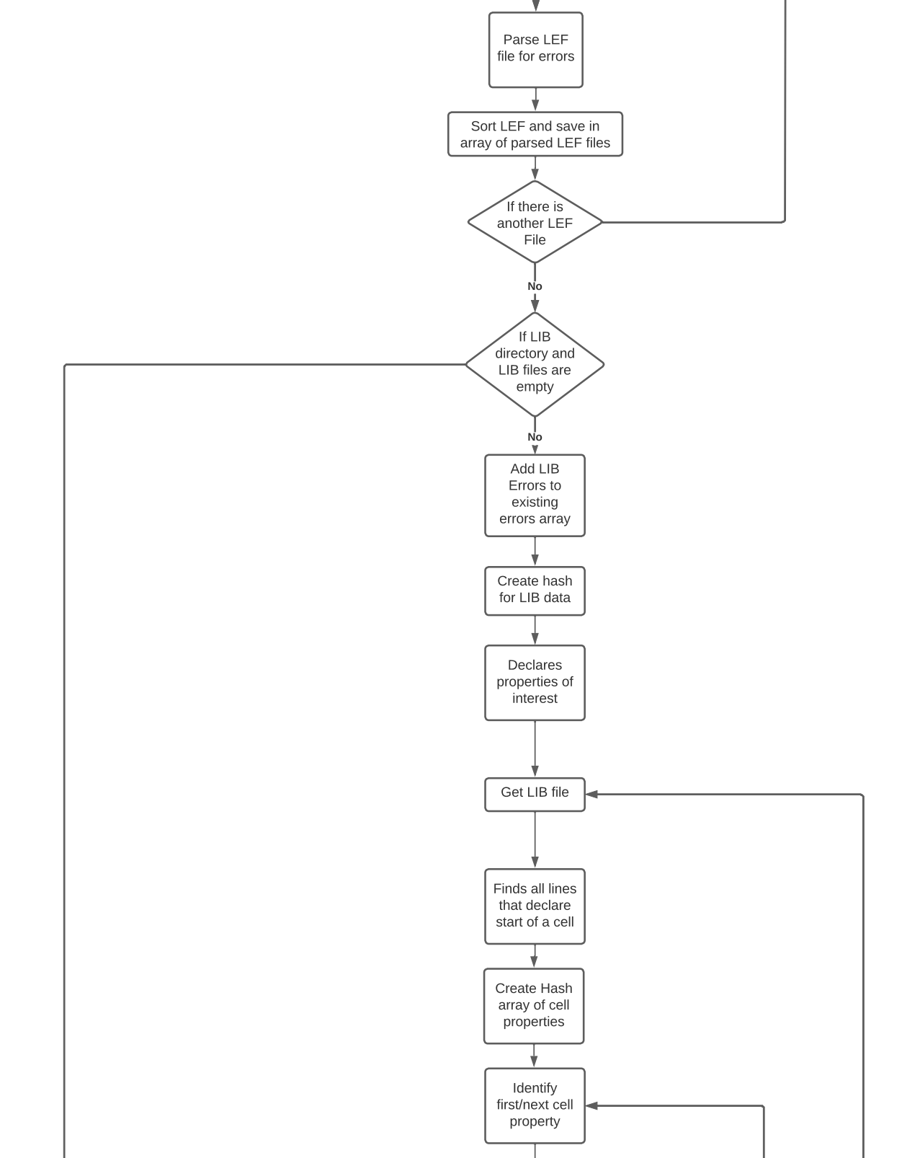
Improvements - Script Flowchart
Notes:
Alicia

Slide 26
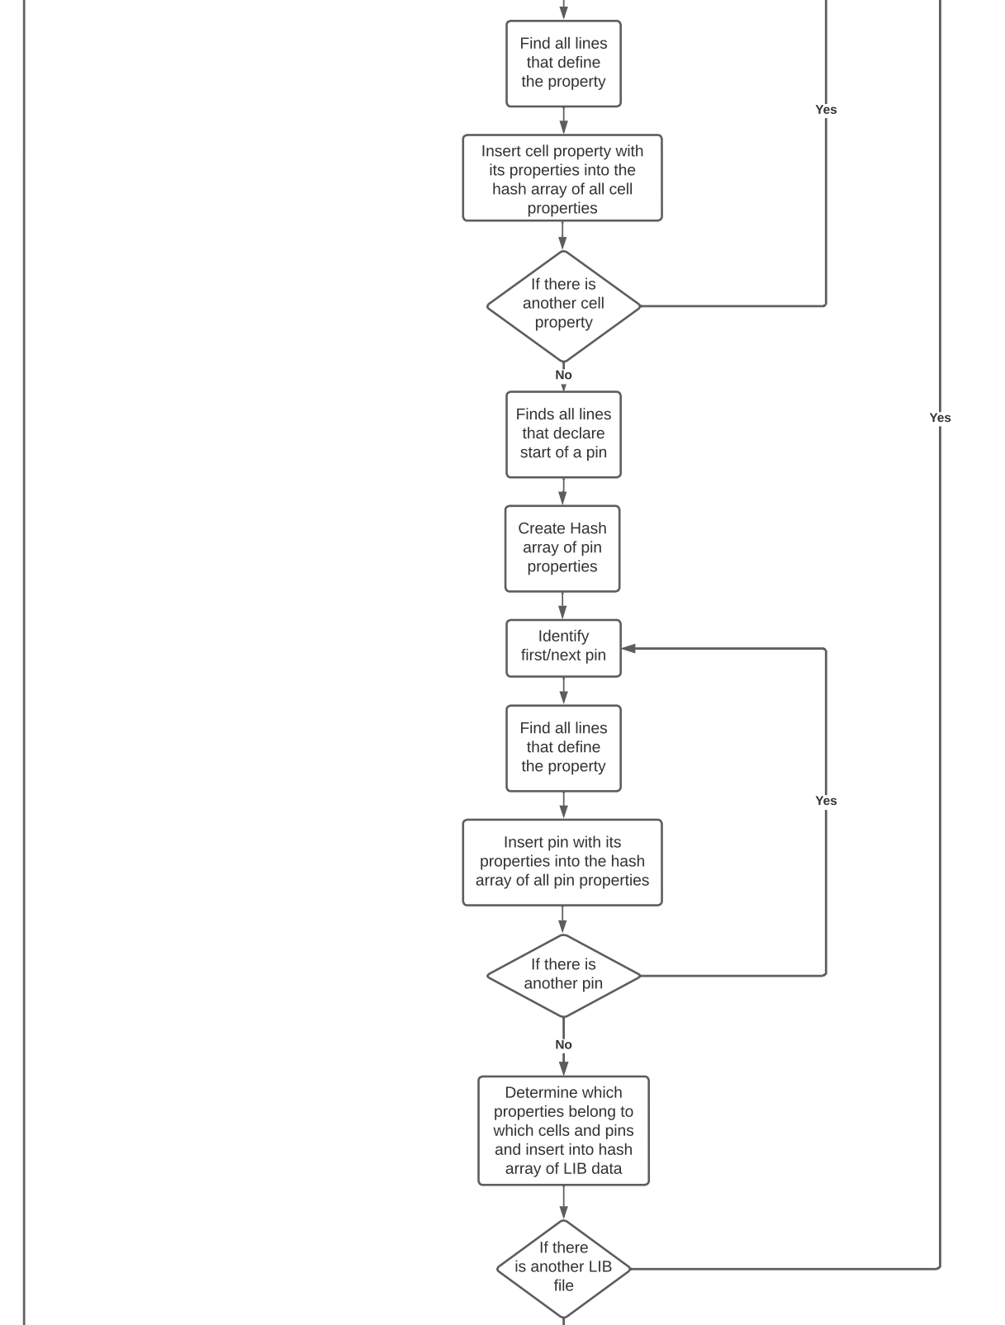
Improvements - Script Flowchart
Notes:
Alicia

Slide 27
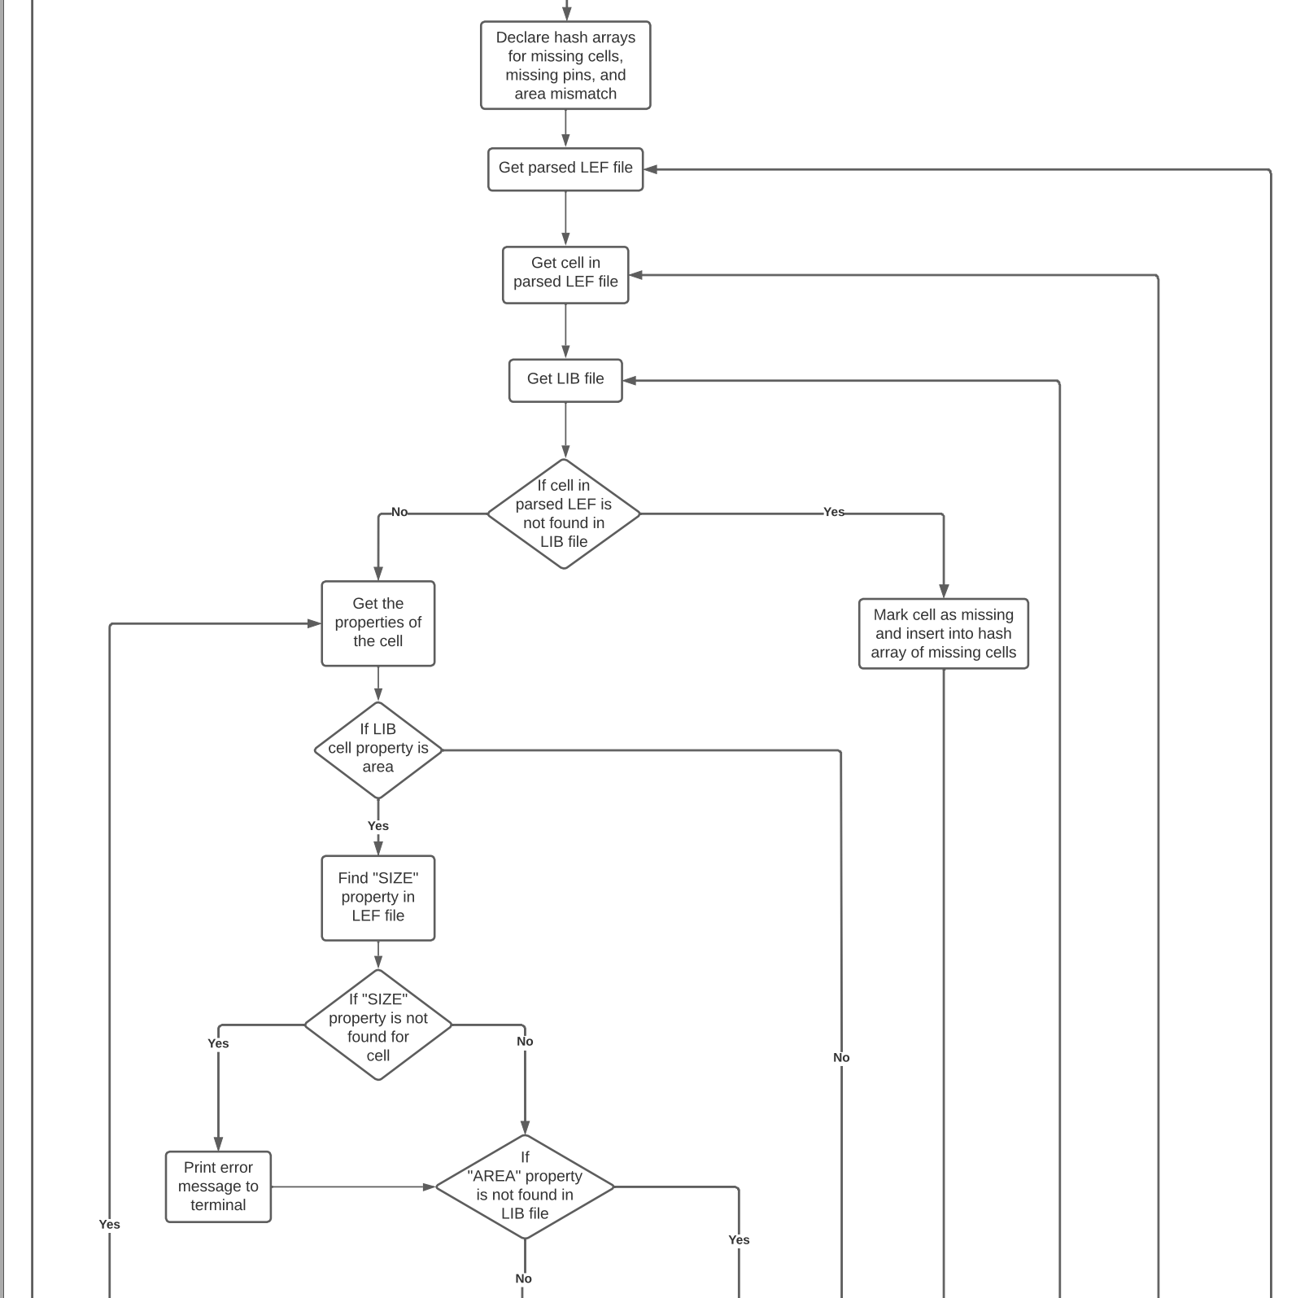
Improvements - Script Flowchart
Notes:
Alicia

Slide 28
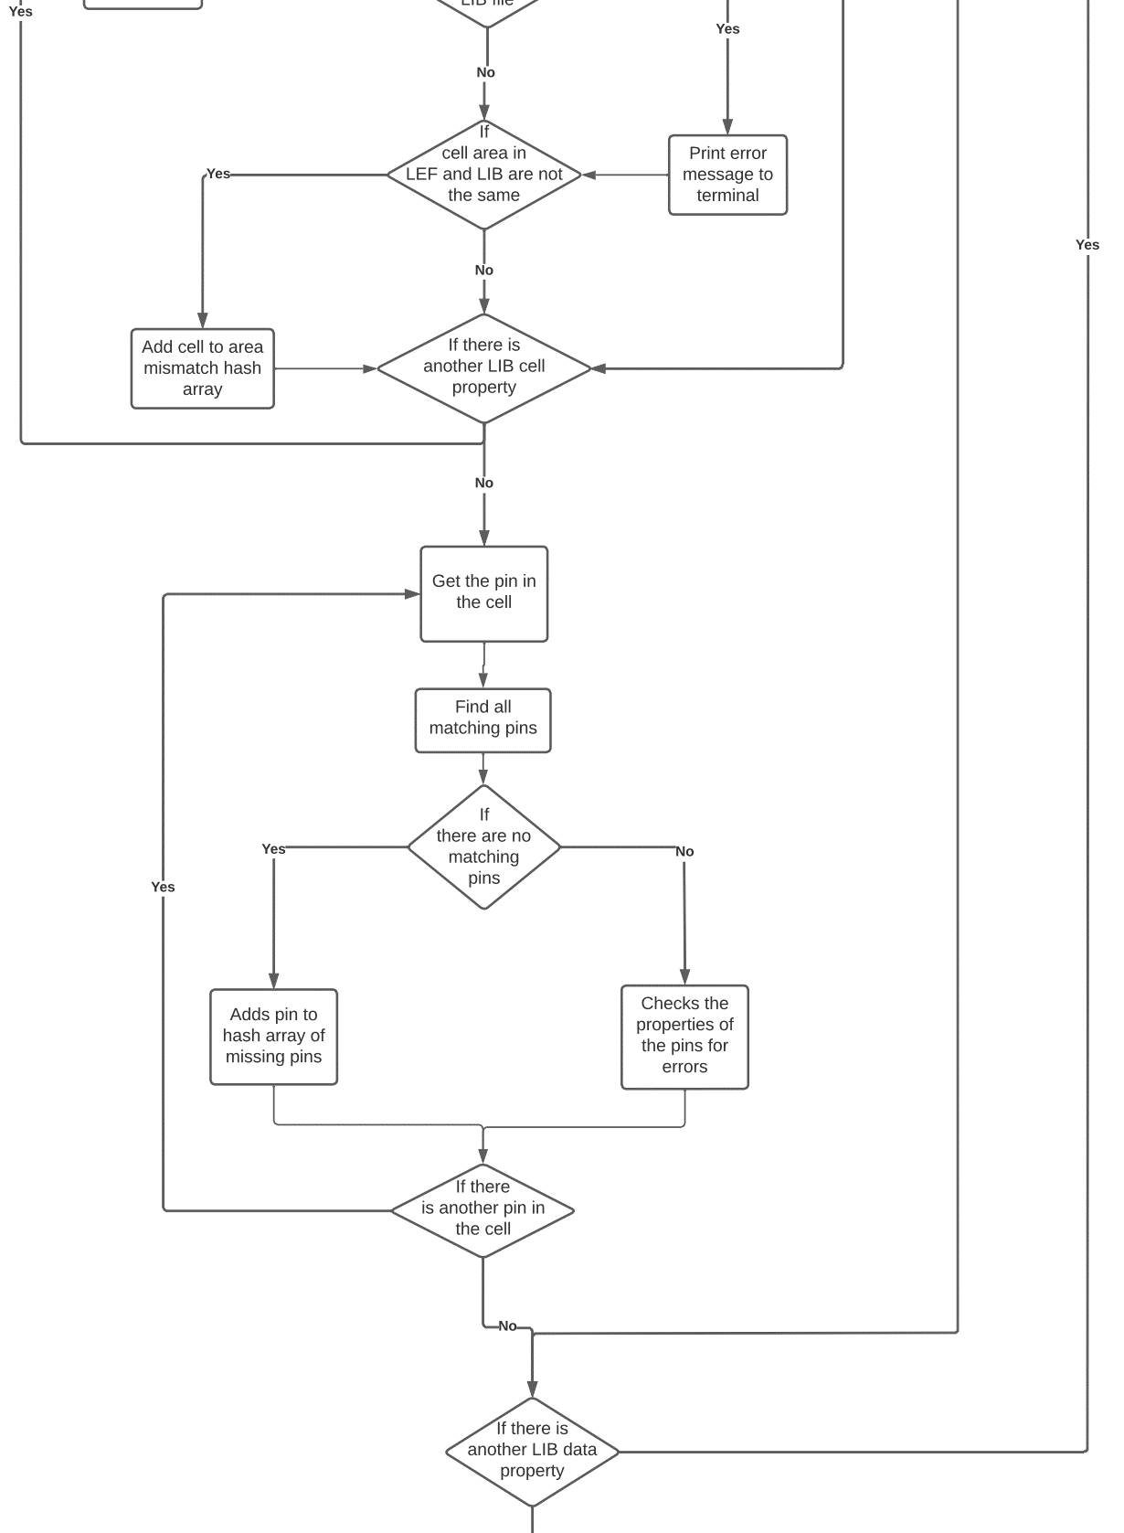
Improvements - Script Flowchart
Notes:
Alicia

Slide 29
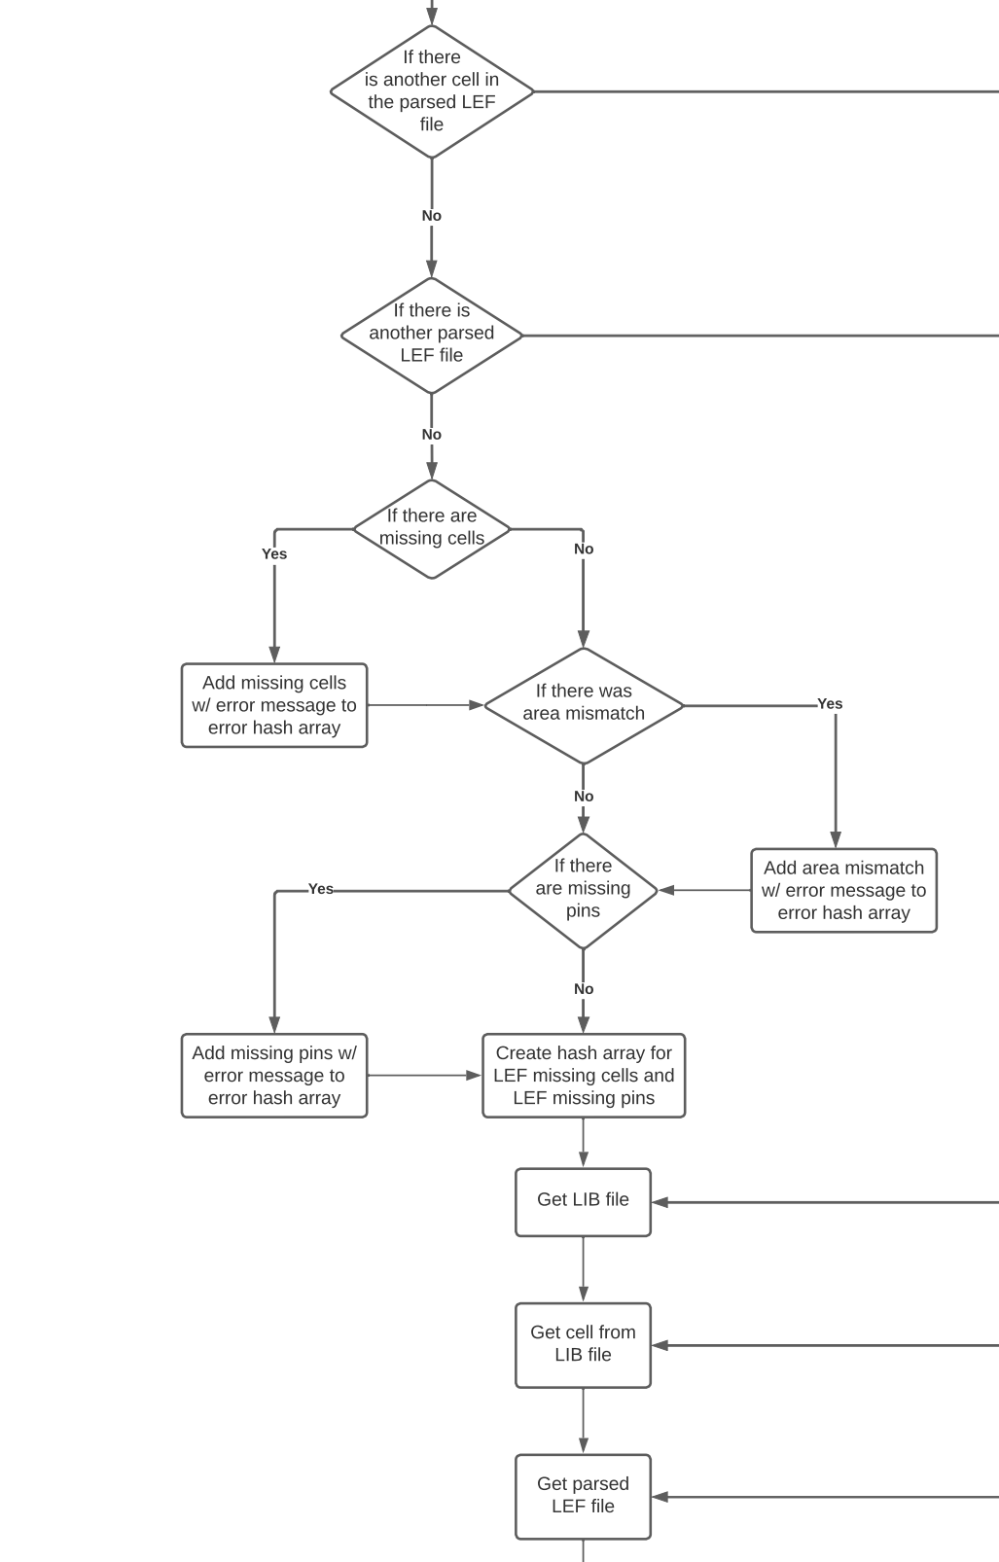
Improvements - Script Flowchart
Notes:
Alicia

Slide 30
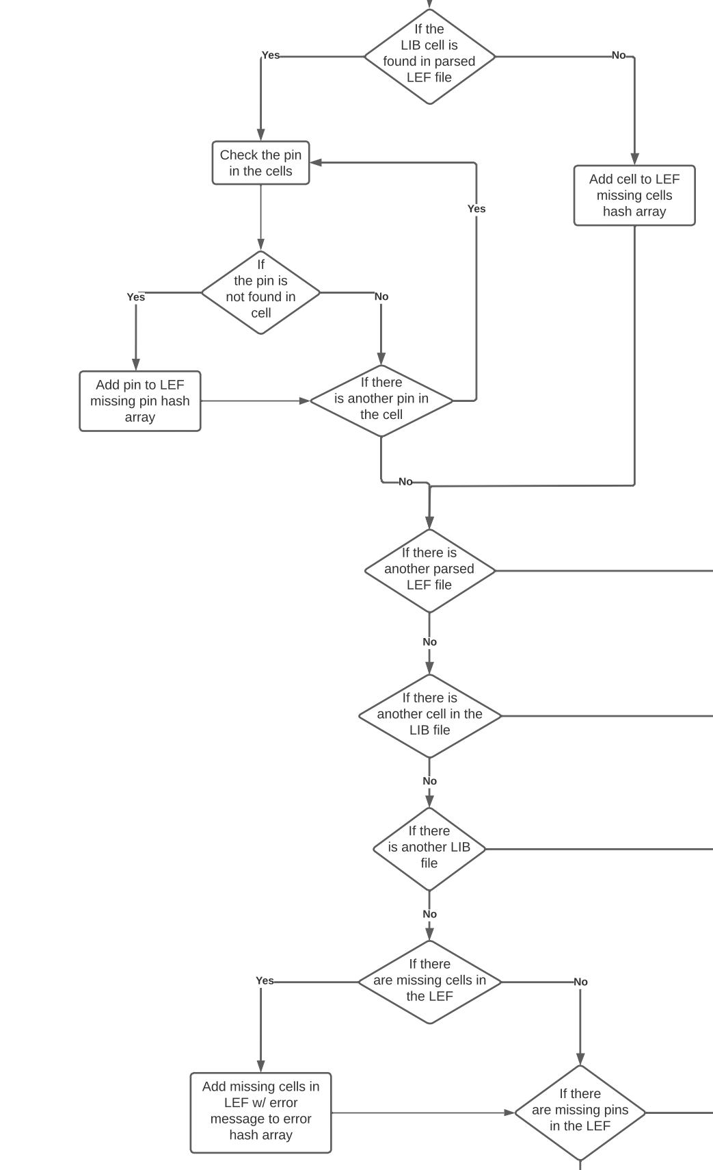
Improvements - Script Flowchart
Notes:
Alicia

Slide 31
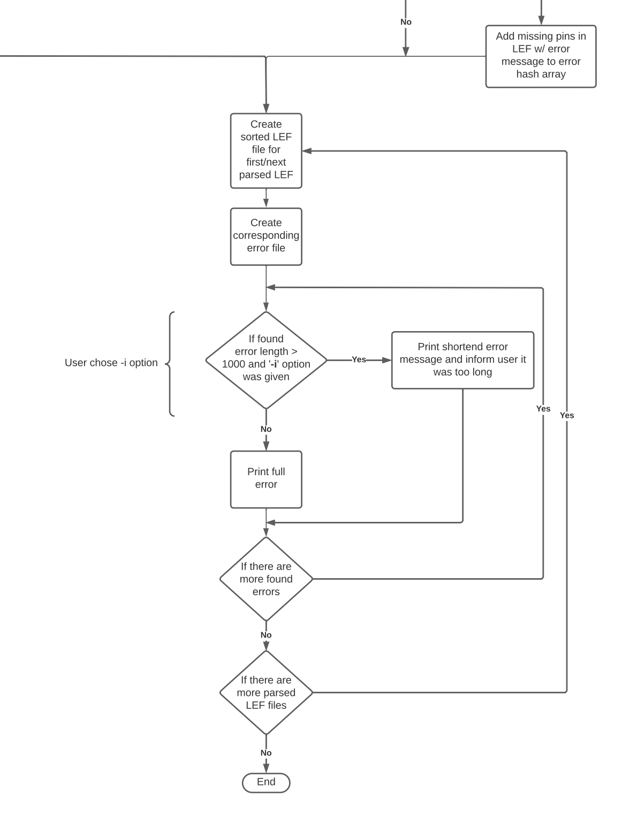
Improvements - Script Flowchart
Notes:
Alicia

Slide 32
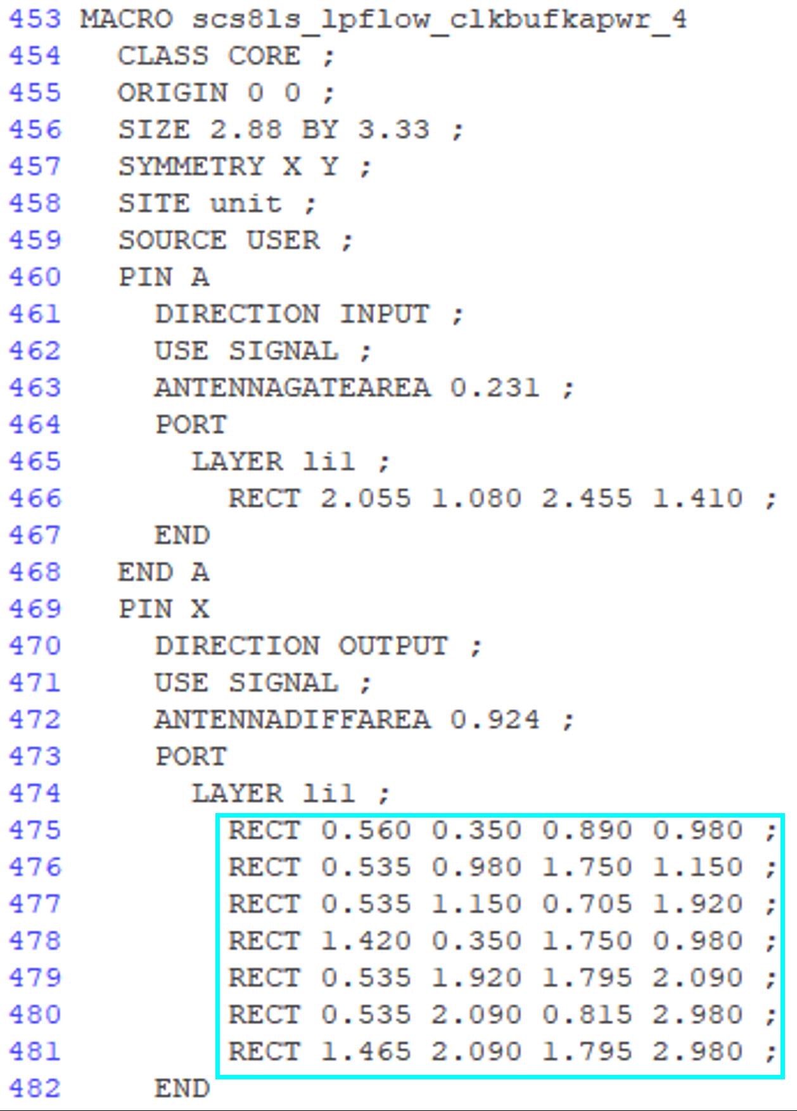
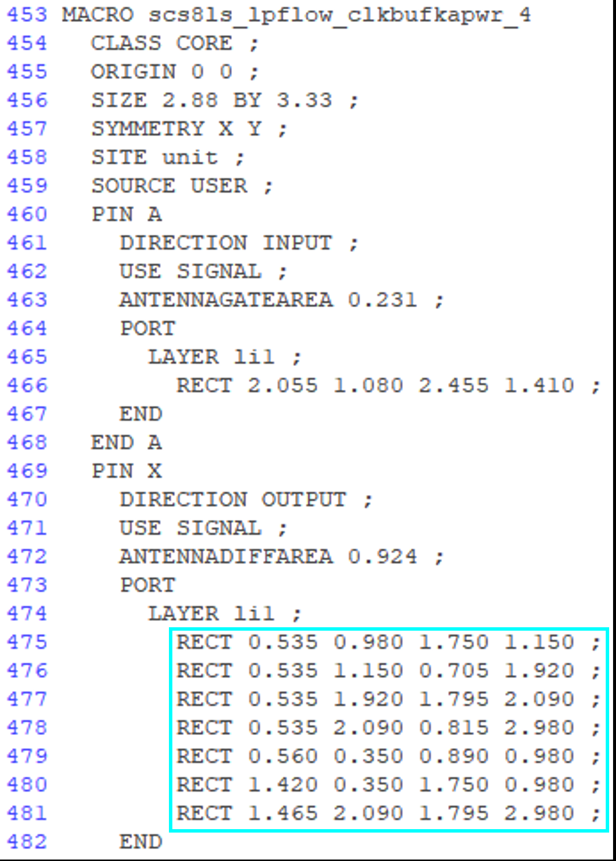
Improvements - Correcting Port Pin Layer Sorting
Initial Script:
After Change:
Not sorted
Sorted
Notes:
Bobby

Slide 33
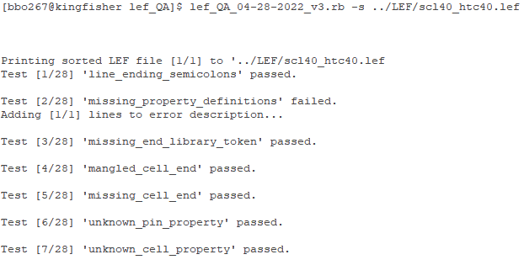
Improvements - Manually passing LEF file
New script option to manually pass in a LEF file
Sorts just the LEF file
Use ‘-s’ for option
Needs to be last option in script execution line, or will result in error
Can optionally pass liberty or techfile as well
Cannot be used with ‘-w’ option
Notes:
Bobby

Slide 34
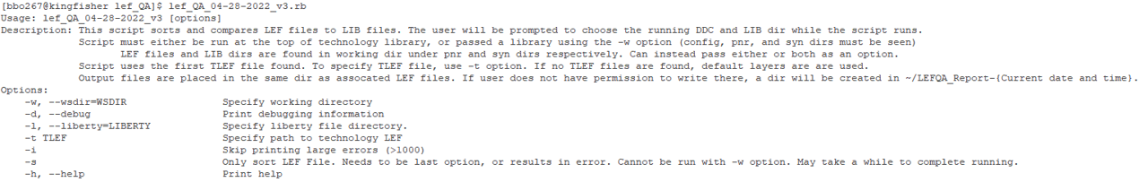
Improvements - Script Execution Clarity
Help menu displays when script is run with no options
Improved clarity on script execution
Indicates where script needs to be executed from
Clarifies where LIB and LEF files are pulled from
Explains how TLEF file is chosen
Specifies where output files will be created
Notes:
Bobby

Slide 35
Improvements - Miscellaneous
Ensured all output files are visible to user
Ensured origin of errors is clear for all tests
Text printed to command prompt window now specifies file and line number corresponding to each error
Notes:
Bobby

Slide 36
Improvements - Summary
✓
No documentation of which LEF syntax keywords aren’t in script
Flowcharts
Poorly represent codebase, not easy to understand
Port Pin Layers are not sorted correctly
No option to manually pass in and sort LEF files
Script execution Clarity
Help menu not displayed when executing without options
Proper execution is not clear to new users
Output file location not clear to users
Miscellaneous
Output files are hidden
Origin of errors is not clear for all tests
✓
✓
✓
✓
✓
Notes:
Bobby
How to properly run the script should be more clear
Running the script with no args should display the help menu (list all different argument options)
Make output dir more obvious when running the script
Make output files more readable
Error files should indicate where the error originates from in the code
Make sure none of the output files are hidden
Improve code readability
Add block comments above classes/methods
TODO statements in code

Slide 37
Future Work
Tech LEF files
Research .techlef files more and determine if script needs to account for these
CONFIG file for parameters and help menu options
Improve code readability
Add block comments above classes/methods
TODO statements in code
Error files should indicate where an error originates in the script code
Add strings of stack traceback calls to error arrays
LEF-LIB Comparison
Script currently compares SIZE in LEF with AREA in LIB, for each cell
Script currently compares pin properties between LEF and LIB files
Need to determine which specific pin properties
Use LEF/DEF Manual to determine what other info between LEF-LIB files needs comparison
SIZE values in cell macros need to be multiples of SIZE values in SITE statement
Enable script to ensure this constraint is satisfied
Notes:
Bobby
TLEF is Cadence. TF is Synopsys
Cell MACRO has SIZE property W X L
-Also has SITE property
Site property has size
Cell MACRO’s SIZE needs to be a multiple of SITE’s size
MACRO and SITE Class’s should match also
SITE – Specifies the name for the placement site

Slide 38
Future Work - Cell VIA OBS layers
4/13 Email
s22sc7tcustom cells are missing VIA1 OBS layers
Causes Innovus to route metals too close to internal metals
LEFs updated to 1.0.18
Solved the VIA1 issue
VIA2 DRC M3.S.8 spacing errors still exist
Need to update cell LEFs to have VIA2 OBS also
s22sc7tcustom updated to 1.0.19
Fixed issue by adding OBS layer for VIA1 and VIA2
4/25 Email
Most of the errors went away but many of the custom cells do not have OBS layers on all the VIAs
Example cell: s22sc7tcustom_fsdprbqm4_y4_svt30_2 is missing VIA1 OBS layer on some of the VIA1s
Causes the following error: VIA1.S.1
Ensure that cells have all VIA OBS layers, or this could cause errors for everyone
Enable script to ensure that all cell VIAS have OBS layers associated with them
Notes:
Chris
For this problem…
Some of the custom cells don’t have OBS layers on all VIAS.
To resolve that problem…
We can have the script check and ensure that all cell VIAS have OBS layers associated with them.

Slide 39
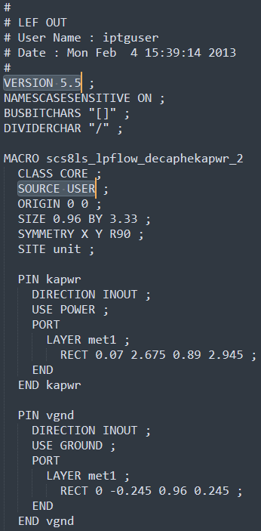


Future Work - SOURCE USER Syntax
scs8ls_lpflow_s8p.lef
LEF/DEF syntax v5.5
Each macro specifies a SOURCE property
LEF/DEF language reference v5.7, v5.8
SOURCE property not part of LEF syntax
Only part of DEF syntax
DEF Syntax:
SOURCE specifies source of component
USER specifies component is generated by user
LEF QA Script
Includes SOURCE as one of the possible LEF syntax keywords
Doesn’t throw errors when SOURCE is included in LEF files
Need to do further research and determine scope of this problem
Notes:
Chris

Slide 40
Future Work - SI² LEF/DEF APIs
Silicon Integration Initiative (SI²)
Formerly CAD Framework Initiative (CFI)
Non-profit consortium of semiconductor, systems, EDA, and manufacturing companies
https://si2.org/
Distributes LEF/DEF APIs in C/C++
LEF/DEF APIs
Created and updated by Cadence
Used to read, write, and manipulate LEF/DEF files
APIs can parse all LEF syntax keywords
Need to explore APIs more and determine tradeoffs for adopting
Notes:
Chris

Slide 41
Conclusion
Improvements Made: LEF QA tool
Fixed issue of Port Pin Layers not sorting correctly
Added option to manually pass in a LEF file to sort
Help menu displays when script is run with no args
Improved clarity in description displayed when running script
Future Work:
Differentiate between tech LEF file types
Set up CONFIG file
Improve code readability
Improve error file output
Compare additional properties between LEF and LIB
Cell VIA obstructions missing
SOURCE USER
SI² LEF/DEF APIs
Notes:
Alicia
End Summary
We fixed this
We didn’t fix this
Can be improved
Here’s how we left it
Next steps…

Slide 42
Backup Slides

Slide 43
Background - LEF Manual Syntax
{LAYER layerName
[EXCEPTPGNET] [SPACING minSpacing | DESIGNRULEWIDTH value] ;
[WIDTH width ;]
{PATH [MASK maskNum] pt ... ;
| PATH [MASK maskNum] ITERATE pt ... stepPattern ;
| RECT [MASK maskNum] pt pt ;
| RECT [MASK maskNum] ITERATE pt pt stepPattern ;
| POLYGON [MASK maskNum] pt pt pt pt ... ;
| POLYGON [MASK maskNum] ITERATE pt pt pt pt ... stepPattern ;
} ...
| VIA [MASK viaMaskNum] pt viaName ;
| VIA ITERATE [MASK viaMaskNum] pt viaName stepPattern ;
} ...
Notes:
Chris

Slide 44
Background - LEF Manual Syntax
[PIN pinName
[TAPERRULE ruleName ;]
[DIRECTION {INPUT | OUTPUT [TRISTATE] | INOUT | FEEDTHRU} ;]
[USE { SIGNAL | ANALOG | POWER | GROUND | CLOCK } ;]
[NETEXPR "netExprPropName defaultNetName" ;]
[SUPPLYSENSITIVITY powerPinName ;]
[GROUNDSENSITIVITY groundPinName ;]
[SHAPE {ABUTMENT | RING | FEEDTHRU} ;]
[MUSTJOIN pinName ;]
{PORT
[CLASS {NONE | CORE | BUMP} ;]
{layerGeometries} ...
END} ...
[PROPERTY propName propVal ;] ...
[PROPERTY LEF58_VIAINPINONLY “VIAINPINONLY ; ” ;]
[ANTENNAPARTIALMETALAREA value [LAYER layerName] ;] ...
[ANTENNAPARTIALMETALSIDEAREA value [LAYER layerName] ;] ...
[ANTENNAPARTIALCUTAREA value [LAYER layerName] ;] ...
[ANTENNADIFFAREA value [LAYER layerName] ;] ...
[ANTENNAMODEL {OXIDE1 | OXIDE2 | OXIDE3 | OXIDE4} ;] ...
[ANTENNAGATEAREA value [LAYER layerName] ;] ...
[ANTENNAMAXAREACAR value LAYER layerName ;] ...
[ANTENNAMAXSIDEAREACAR value LAYER layerName ;] ...
[ANTENNAMAXCUTCAR value LAYER layerName ;] ...
END pinName]
Notes:
Chris

Slide 45
Background - LEF Manual Syntax
[OBS
{LAYER layerName
[EXCEPTPGNET]
[SPACING minSpacing | DESIGNRULEWIDTH value] ;
[WIDTH width ;]
{ PATH pt ... ;
| PATH ITERATE pt ... stepPattern ;
| RECT pt pt ;
| RECT ITERATE pt pt stepPattern ;
| POLYGON pt pt pt pt ... ;
| POLYGON ITERATE pt pt pt pt ... stepPattern ;
} ...
| VIA pt viaName ;
| VIA ITERATE pt viaName stepPattern ;
} ...
END]
Notes:
Chris

Slide 46
Background - LEF Manual Syntax Definitions
VERSION | – Specifies which version of the LEF syntax is being used
BUSBITCHARS | – Specifies the pair of characters used to specify bus bits when LEF names are mapped to or from other databases
DIVIDERCHAR | – Specifies the character used to express hierarchy when LEF names are mapped to or from other databases
VIA | – Defines two types of vias: fixed vias and generated vias
SITE | – Defines a placement site in the design – A placement site gives the placement grid for a family of macros
MACRO | – Specifies the macro type – If you do not specify CLASS, the macro is considered a CORE macro
BEGINEXT | – Adds customized syntax to the LEF file that can be ignored by tools that do not use that syntax – You can also use extensions to add new syntax not yet supported by your version of LEF/DEF, if using v5.1 or later
END LIBRARY | – Indicates end of LEF files
Notes:
Chris

Slide 47
Background - LEF Manual Syntax Definitions
MACRO *Definitions from Cadence LEF/DEF Reference v5.8
CLASS | – Specifies the macro type; CORE by default
FIXEDMASK | – Indicates that the specified macro does not allow mask-shifting
FOREIGN | – Specifies the foreign (GDSII) structure name to use when placing an instance of the macro – Options: pt specifies macro-origin coordinate; orient specifies orientation of the foreign cell
ORIGIN | – Specifies how to find the origin of the macro to align with a DEF COMPONENT placement point (pt)
EEQ | – Specifies that the macro being defined should be electrically equivalent to the EEQmacroName
SIZE | – Specifies a placement bounding rectangle that stretches from (0, 0) to (width, height), in microns, for the macro
SYMMETRY | – Specifies which macro-orientations should be attempted by the placer before matching to the site of the underlying rows
SITE | – Specifies the name for the placement site
PIN | – Defines pins for the macro
OBS | – Defines obstructions on the macro
DENSITY | – Specifies the metal density for large macros
PROPERTY | – Specifies a numerical/string value (propVal) for a macro property (propName) defined in the PROPERTYDEFINITIONS statement
Notes:
Chris

Slide 48
Background - LEF Manual Syntax Definitions
Layer Geometries – Used in the macro obstruction (OBS) and pin port (PIN) statements
LAYER | – Specifies the layer on which to place the geometry
EXCEPTPGNET | – Indicates that the obstruction shapes block signal routing, but do not block power or ground routing
SPACING | – Specifies the minimum spacing allowed between this particular OBS and any other shape
DESIGNRULEWIDTH | – Specifies the effective design rule width
WIDTH | – Specifies the width that the PATH statements use
PATH | – Creates a path between the specified points
MASK | – Specifies which mask from double- or triple-patterning to use for this shape
ITERATE | – Creates an array of the PATH, RECT, POLYGON, or VIA geometry, as specified by the given step pattern
RECT | – Specifies a rectangle, where the two points specified are opposite corners of the rectangle
POLYGON | – Specifies a sequence of at least three points to generate a polygon geometry
VIA | – Specifies the via to place, and the placement location
Notes:
Chris

Slide 49
Background - LEF Manual Syntax Definitions
PIN
TAPERRULE | – Specifies the nondefault rule to use when tapering wires to the pin
DIRECTION | – Specifies the pin type
USE | – Specifies how the pin is used; required for timing analysis
NETEXPR | – Specifies a net expression property name (such as power1 or power2) and a default net name
SUPPLYSENSITIVITY | – Specifies that if this pin is connected to a tie-high connection, it should connect to the same net to which powerPinName is connected
GROUNDSENSITIVITY | – Specifies that if this pin is connected to a tie-low connection, it should connect to the same net to which groundPinName is connected
SHAPE | – Specifies a pin with special connection requirements because of its shape
MUSTJOIN | – Specifies the name of another pin in the cell that must be connected with the pin being defined
PORT | – Indicates that the following LAYER, POLYGON, and VIA statements are all part of one PORT connection, until another PORT statement occurs
PROPERTY | – Specifies a numerical/string value (propVal) for a macro property (propName) defined in the PROPERTYDEFINITIONS statement
PROPERTY LEF58_VIAINPINONLY | – Specifies that vias must be dropped inside the original pin shapes to connect to the pin, and planar connection to the pin is not allowed
Notes:
Chris

Slide 50
Background - LEF Manual Syntax Definitions
PIN
ANTENNAPARTIALMETALAREA | – Specifies the partial metal area connected directly to the I/O pin and the inside of the macro cell on the layer
ANTENNAPARTIALMETALSIDEAREA | – Specifies the partial metal side wall area connected directly to the I/O pin and the inside of the macro cell on the layer
ANTENNAPARTIALCUTAREA | – Specifies the partial cut area above the current pin layer and inside the macro cell on the layer
ANTENNADIFFAREA | – Specifies the diffusion (diode) area, in micron-squared units, to which the pin is connected on a layer
ANTENNAMODEL | – Specifies the oxide model for the pin
ANTENNAGATEAREA | – Specifies the gate area, in micron-squared units, to which the pin is connected on a layer
ANTENNAMAXAREACAR | – Specifies the maximum cumulative area ratio value on the specified layerName using the metal area at or below the current pin layer, excluding the pin area itself
ANTENNAMAXSIDEAREACAR | – Specifies the maximum cumulative antenna ratio value on the specified layerName, using the metal side wall area at or below the current pin layer, excluding the pin area itself
ANTENNAMAXCUTCAR | – Specifies the maximum cumulative antenna ratio value on the specified layerName using the cut area at or below the current pin layer, excluding the pin area itself
Notes:
Chris

Slide 51
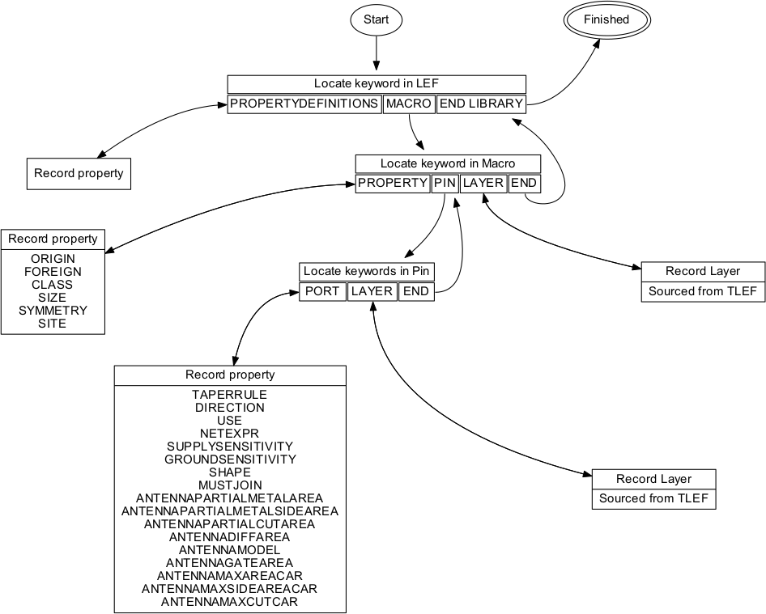
Prior Work - Parsing a LEF File
*This flowchart was created by the Fall 2019 group (Josh Ashley, James Exterkamp and Matthew Miller)
Notes:
Alicia

Slide 52
Prior Work - TLEF/TF Parsing
Given TLEF/TF filename, read layer names
Similar Parsing Structure
Only one instantiated per run, depending on DDC
If .tlef exists use that, otherwise use .tf
Parse chosen file, generate array of layers
Use these layers for LEF verification

Slide 53
Prior Work - TLEF Parsing
User calls
User initializes with
TLEF_FILE object
TLEF_PARSE
Parses TLEF file into tlef_layers hash
Calls private methods
TLEF path
INITIALIZE
Verify file existence
Declare ALL instance variables
_MATCH_BEGIN_LAYER
Matches layer begin statement
Adds begin line number to tlef_layers hash
@tlef_fn
@tlef_layers
LAYERS
Returns layer keys from @tlef_layers
User calls
_MATCH_END_LAYER
Matches layer end statement
Adds end line number to tlef_layers hash
Layers Array
*This flowchart was created by the Fall 2019 group (Josh Ashley, James Exterkamp and Matthew Miller)

Slide 54
Prior Work - TF Parsing
User calls
User initializes with
TF_FILE object
TF_PARSE
Parses TF file into layers array
Looks for techLayers section
Scans lines, append layer until end of techLayers found.
TF path
INITIALIZE
Verify file existence
Declare ALL instance variables
@tlef_fn
@layers
LAYERS
@layers getter
User calls
@layers
@layers
*This flowchart was created by the Fall 2019 group (Josh Ashley, James Exterkamp and Matthew Miller)

Slide 55
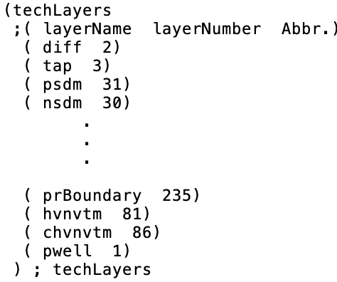
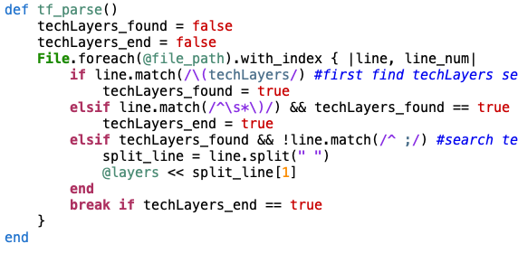
Prior Work - TF Code Sample
Techfile.tf
Parser
*This flowchart was created by the Fall 2019 group (Josh Ashley, James Exterkamp and Matthew Miller)

Slide 56
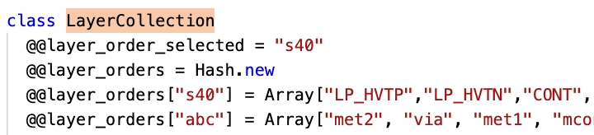
Prior Work - Layer Usage
Original LayerCollection has hard-coded layer arrays
Overwrite with TF/TLEF data when present

Slide 57
Prior Work - Pin direction Checks
Pin direction exists under LEF and LIB pins
Need to take existing data structures and extract that info for each pin
Liberty_Pin does not extract any properties
Should extract “direction”
Made to be generic

Slide 58
Prior Work - Liberty Rule Checks
Liberty Checker calls with:
(lef_pin, lib_pin, lib_prop_key)
LibRuleChecker class
Check_pin_value_in_lef
LEF Pin Properties: [“ DIRECTION INPUT ;\n”, “USE SIGNAL ;\n” ,” ANTENNAMODEL OXIDE1 ; \n” … ]
LIB Pin Properties: {“direction”=>”input” …}
Setup REGEXs to match LEF string to LIB key and LIB value
If regex searches not empty no error
Else, missing property error.
*This flowchart was created by the Fall 2019 group (Josh Ashley, James Exterkamp and Matthew Miller)

